Slide 1
Madrasah Lite
Lesson 1

Slide 2
Intro
Aqeedah:
The first article of faith – Belief in Allah
Seerah:
The early childhood of the Prophet ﷺ – his birthplace, family, and tribe
Hadith/Sunnah:
The reward for sending salutations (Salaam) upon the Prophet ﷺ

Slide 3
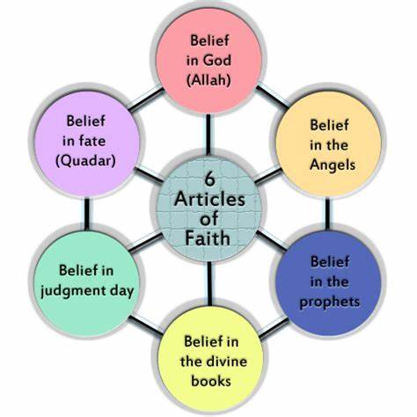
A Lesson on Aqeedah
6 Articles of Faith Overview
Belief in Allah
Belief in the Angels
Belief in the Revealed Books
Belief in the Messengers
Belief in the Last Day
Belief in Divine Decree (Qadar)

Slide 4
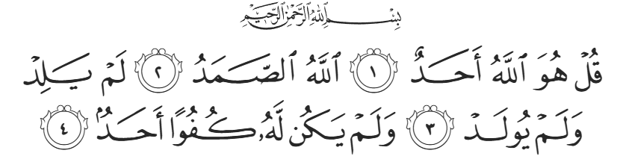
A Lesson on Aqeedah (cont.)
“Say, He is Allah the One. Allah the Eternal. He does not beget nor is he begotten. And there is nothing like him”
- Surah Al-Ikhlas (112)
Notes:
Allah is ONE!
Surah Al-Ikhlas (112) summarizes this
He is the Only One Worthy of Worship
Muslims pray, ask for help, and rely only on Allah.
Worshipping others besides Him (like idols, saints, or the dead) is called shirk, the worst sin in Islam.

Slide 5



Names of Allah
Al-Khaliq
Al-’Aleem
Ar-Rahman
The Creator
The All-Knowing
The Most Merciful
Notes:
🌟 Ar-Rahmaan – The Most Merciful
Allah is very, very kind and loving to everyone — even if they don’t ask or don’t thank Him
🗯️Imagine this:
When you're sleeping, Allah still gives you air to breathe.
When you're playing, He gives you the sun, your eyes to see, and your heart to feel joy.
It’s like when your mom or dad takes care of you all the time — even when you don’t say thank you — but even more! That’s Ar-Rahmaan.
🌟 Al-‘Aleem – The All-Knowing
Allah knows everything — every little thing you do, think, or feel.
🗯️Imagine this:
Even if you whisper something, or just think it in your head, Allah knows it.
If a tiny ant is walking in the dark under a rock… Allah knows that too!
🌟 Al-Khāliq – The Creator
Allah is the One who made everything — from the stars in the sky to the tiny bugs on the ground
🗯️Imagine this:
When you draw a picture, you make something — but Allah made real people, animals, trees, and planets from nothing at all!
He didn’t need tools or help. He just says “Be!” and it happens
He Created Everything and Controls Everything
🌳 Allah created the heavens, the earth, and all living beings.
🌸 Nothing happens except by His will

Slide 6
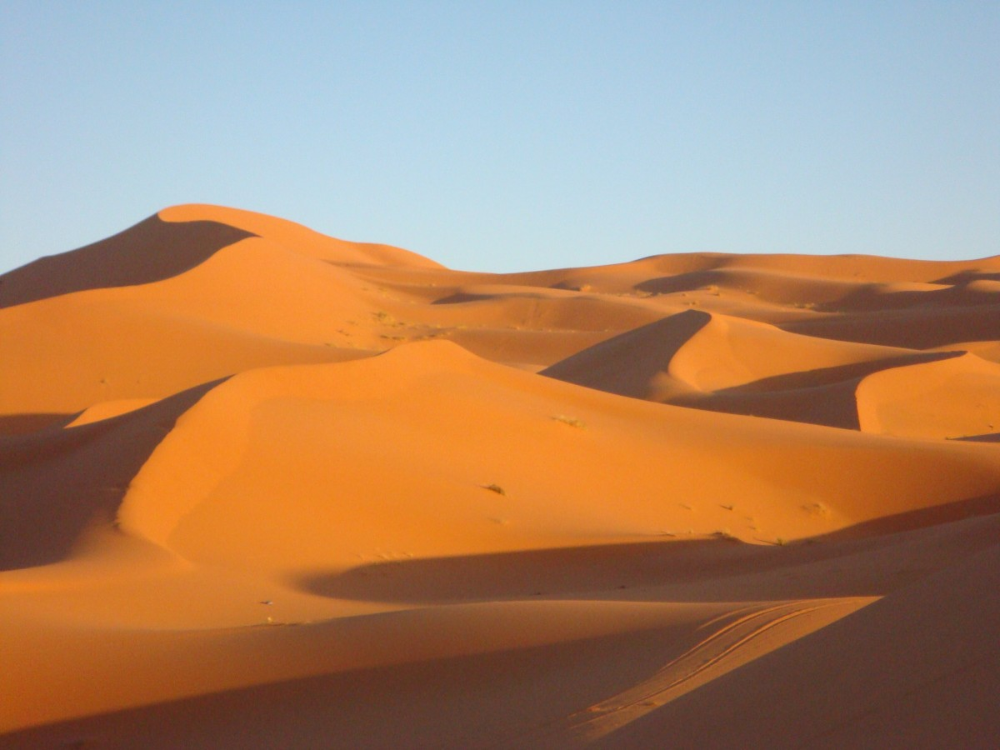


A Lesson on Seerah
When and Where Was He Born? 🏜️
Year of the Elephant (around 570 CE)
Born in Makkah
His Noble Family 👨‍👩‍👦
Tribe: Quraysh
Great-grandfather: Hashim
Grandfather: Abdul Muttalib
Father: Abdullah (passed away before he was born)
Mother: Aminah
Uncle who took care of him: Abu Talib
Notes:
Who Took Care of Him? ❤️
Mother (Aminah) until age 6
Grandfather (Abdul Muttalib) until age 8
Uncle (Abu Talib) afterward

Slide 7
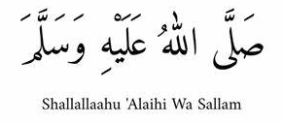
A Lesson on Hadith/Sunnah
Send blessing on the Prophet Muhammad (Shallallaahu ‘Alaihi Wa Sallam)

